Slide 1
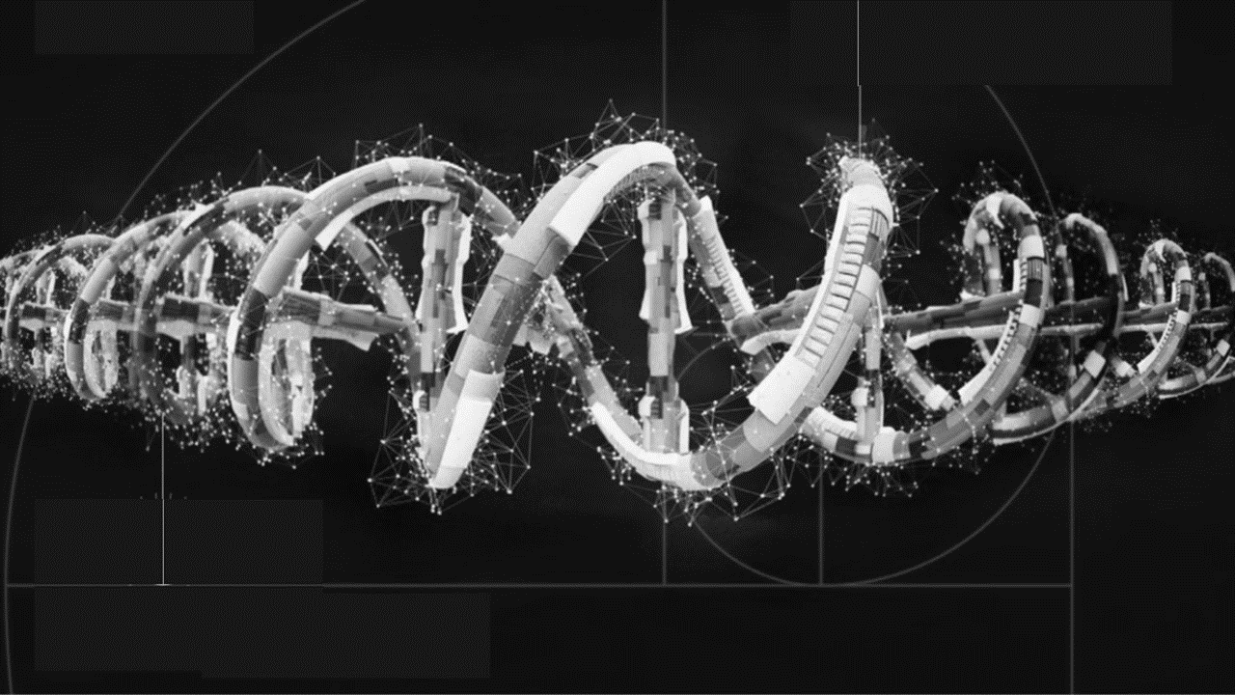
Spatial Omics Platform
Shyam Prabhakar, Kok Hao Chen
Spatial and Single Cell Systems
Genome Institute of Singapore

Slide 2


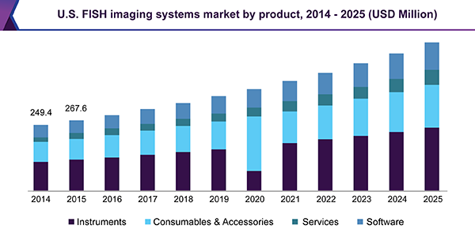
Objective: Disruption of Histopathology, Omics Research Markets
Research market | Clinical market
Immune profiling Cancer genomics Developmental biology Neurobiology | Histopathology. Companion diagnostic. Predict disease recurrent risk. Prenatal tests
Research Market for Spatial Omics Expected to Grow to $1.4B in 2023*
609
329
# of samples (000s)
131
9
40
Source: Chrysalis Biomedical Associates model, 2019
1
*Does not include data analytics / services
2018
2019
2020
2021
2022
2023

Slide 3


Clinical Need for Histopathology
Current options
Current options
Cancer? From where? Which type?
Limited info, subjective: morphology, some stains
How abnormal are the cells?
Limited info, subjective: cell and tumor morphology
Cancer Diagnosis
Cancer Grade
Detect Effects of Therapy
Stratify Patients for Therapy
Current options
Current options
Tumor size only
Inflammation? Drug-induced injury?
Morphology uninformative
Treat based on individual markers
Heterogeneity within tumor?

Slide 4


Pisces Spatial Omics Collaboration: GIS - Applied Materials
Project
PISCES
SCISSOR
IAF-PP
GIS
4

Slide 5
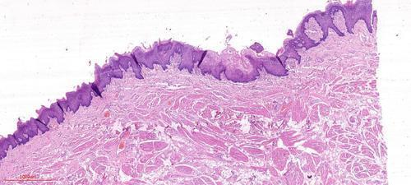
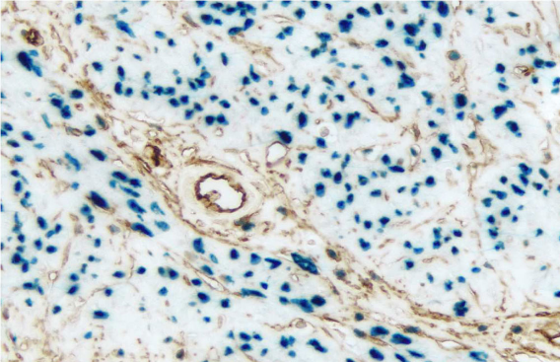
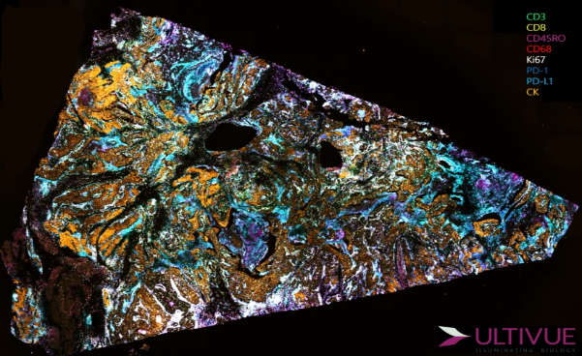
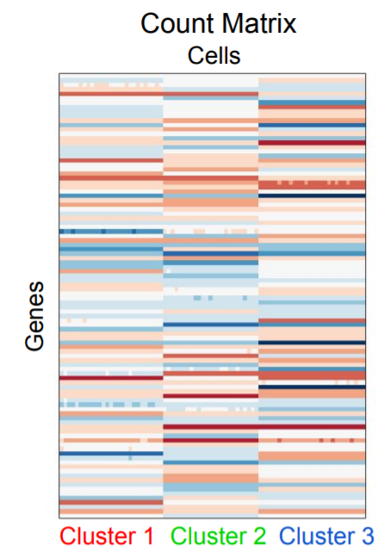
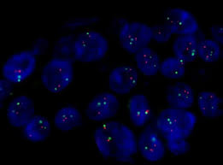
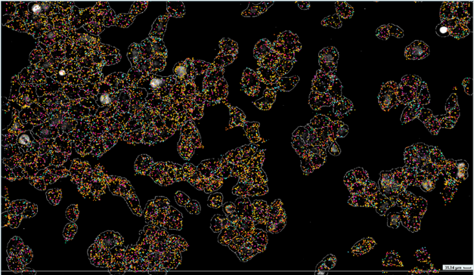
Disruptive Technology: Past, Present, Future of Histopathology
 | 1870s | 1940s / 1980s | ~2010 | ~2020
Cell Morphology
Protein
DNA / RNA
H&E* Stained Tissue
2-3 proStandard Cytochemistry
tein markers
4-10 protein markers
10-30 protein markers
Fluorescent In Situ Hybridization
(“FISH“) 2-3 RNA markers
Single Cell RNA Sequencing
10,000s RNA markers
>10,000 cells in tissue
100-1000s RNA markers
*H&E = Hematoxylin & Eosin
Yen Hsiang Tham, Applied Materials
5

Slide 6
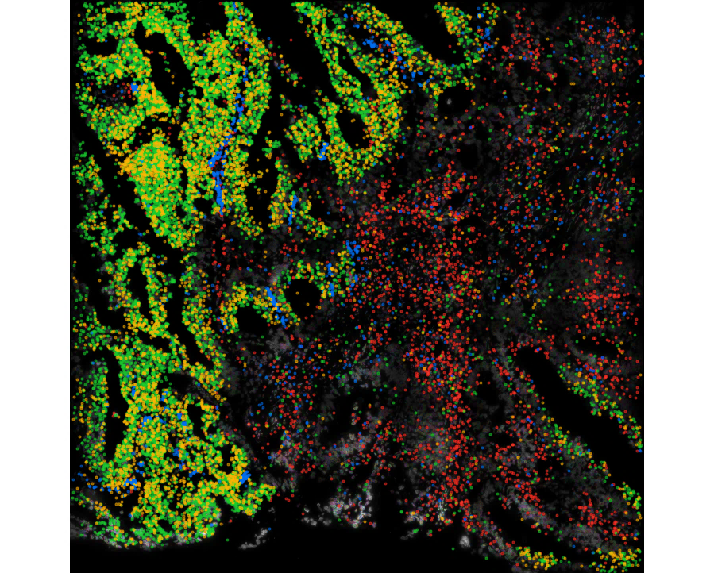
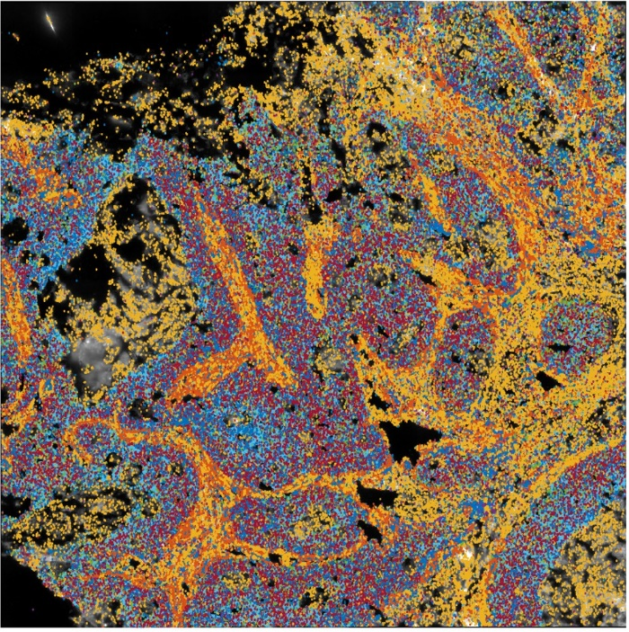
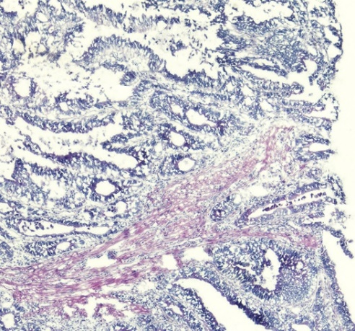
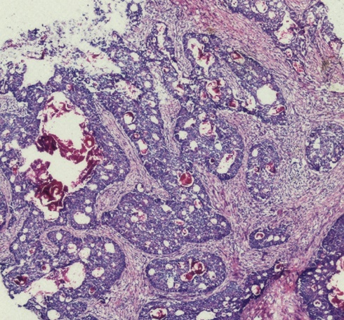

SCISSOR Apps: Colorectal Tumor Immunology mFISH
6

Slide 7
Histopathology: the Future is Spatial
1000s of markers in 1 integrated assay:
Quantitative spatial map
Origin, composition
Cancer? From where? Which type?
Limited info, subjective: morphology, some stains
How abnormal are the cells?
Limited info, subjective: cell and tumor morphology
Accurate spatial map of cancer cell aggressiveness, 100s of markers
Cancer Diagnosis
Cancer Grade
Spatial Histopath
Spatial Histopath
Detect Effects of Therapy
Stratify Patients for Therapy
Spatial Histopath
Spatial Histopath
Comprehensive spatial map: all targetable markers
High resolution of immune infiltration
Activity of immune cells
“Health” of cancer cells
Spatial heterogeneity of response
Are immune cells invading and attacking?
Tumor size only
Inflammation? Drug-induced injury?
Morphology uninformative
Treat based on individual markers
Heterogeneity within tumor?

Slide 8




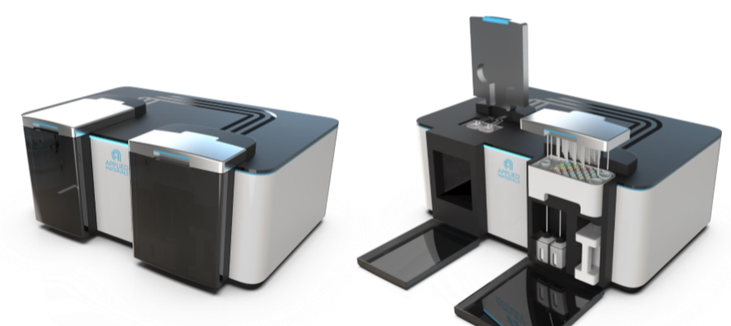
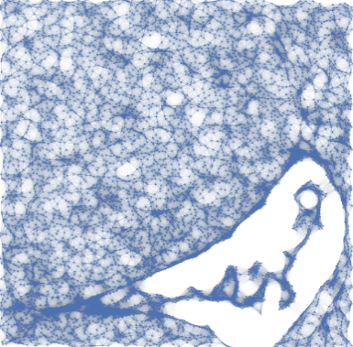
Applied Spin-off from Pisces: Veranome
: world’s first sample-to-insight high-plex spatial omics solution for single cell profiling
Kits: Research & Diagnostics “Apps”
Image
Analytics Algos
Pisces Device/Hardware
8

Slide 9
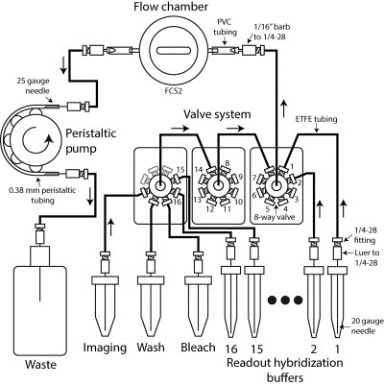
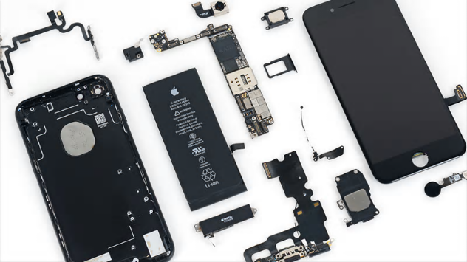






Strategy: Platform (Pisces) + Diagnostic “Apps” (SCISSOR)
Commercial system (2019- )
PISCES
Lab DIY system
(2018)
Platform
Immunotherapy
SCISSOR
Convergence:
3 Apps on PISCES platform
Liquid biopsy
Diagnostic Mutations
Diagnostics “Apps”

Slide 11
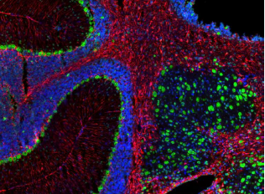
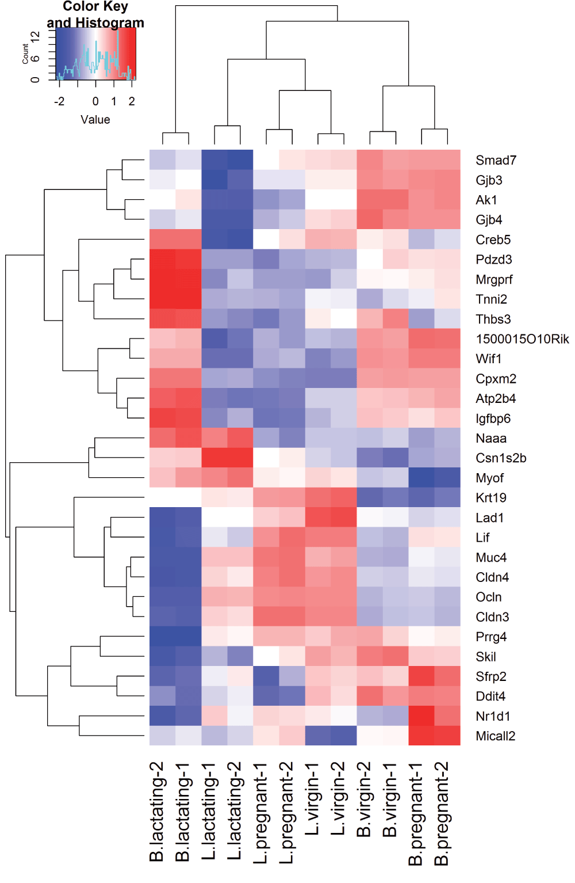
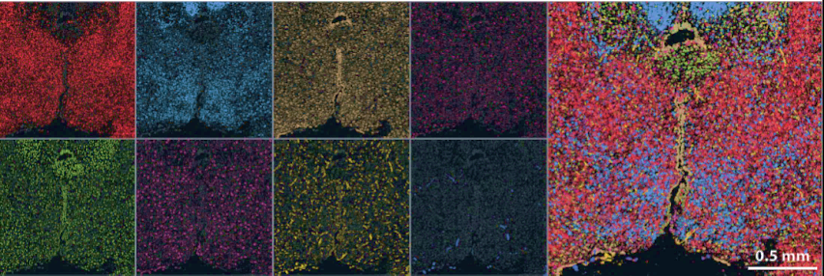
Objective: Disruption of Histopathology, Omics Research Markets
Traditional Pathology
Traditional Genomics
Spatial Omics
2-3 genes
✗ Quantitative
✗ Spatial information
Quantitative
Spatial information: >1,000 genes
Quantitative
PISCES: hi-res, low-cost commercial systems for research + diagnostics
11

